Slide 1

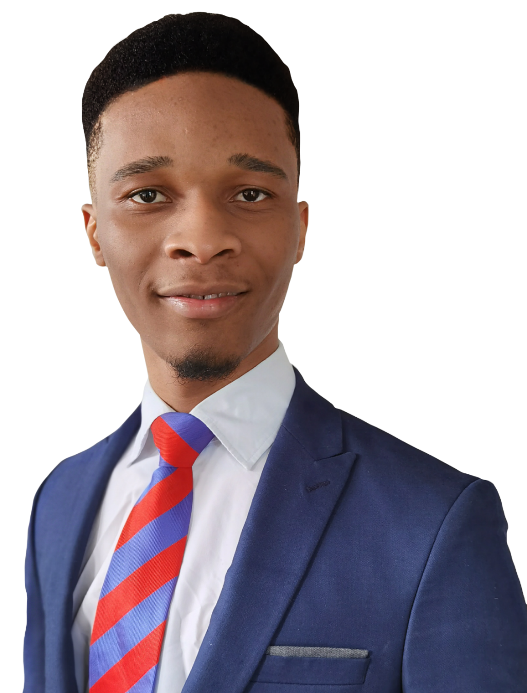
SOO
Home About Work Contact
Hello,
I´m Solomon.
Front End Developer
Check my works

Slide 2
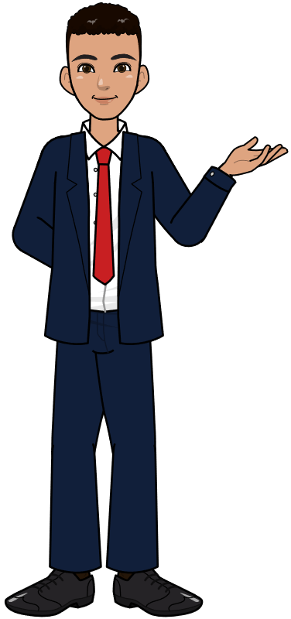

SOO
Home About Work Contact
About Me
I´m a 22-year-old frontend developer with a freelance background in Graphics Design, currently studying computer science in the university of Siegen.
With a combination of graphics designing and software development, I look for creative way to write efficient codes without compromising on the asthetics of my projects.
I´m very interested in the software development spectrum and very much open to learning more technology with an ultimate goal of becoming a Full-Stack developer.
Feel free to reach out to me by using the contact form below or by clicking here.

Slide 3
SOO
Home About Work Contact
Portfolio
Some of my finest Projects
To learn more about my design process using my wesite as a case study please click on the button below.
Design process

Slide 4
SOO
Home About Work Contact
Typical Design Process
The plan to document my process was initially not considered. I was however inspired to include this process in this project by the social media challenge “How it started vs How it´s going”. So the pictures below should give you an insight of how the project all started and the fact that you´re reading this here is a result of how it´s going. “How it´s going” because I believe there is still a lot of room for improvement.

Slide 5
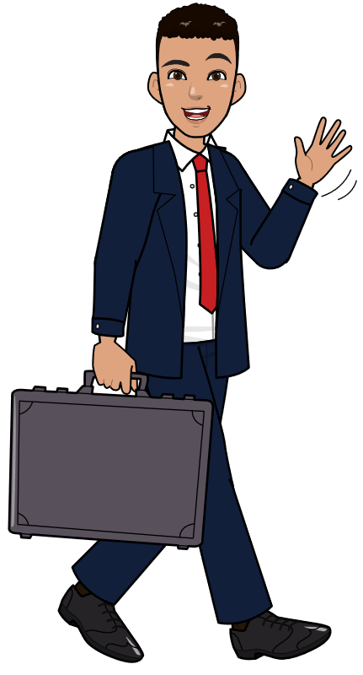





SOO
Home About Work Contact
Contact Me
Your Name
Company
E-mail
Message
Subject
Ich bin kein Roboter
Send
Find me on:
Copyright© 2021 Solozo.page

Slide 6
SOO
Home About Work Contact
Hello,
I´m Solomon.
Looking for my next opportunity to make a change.

Slide 7
SOO
Home About Work Contact
About Me
Freshman in Computer Science at the University of Siegen.

Slide 8
SOO
Home About Work Contact
Hello,
I´m Solomon.
Front End Developer
Check my works

Slide 9
SOO
Home About Work Contact
Portfolio

Slide 10
SOO
Home About Work Contact
Contact Me
Your Name
Message
E-mail
Subject
Send
Find me on:
Copyright© 2021 SOO. All rights reserved

Slide 11
SOO
SOO
SOO
SOO
About Me
Portfolio
Contact Me
Hello,
I´m Solomon.
Your Name
E-mail
Subject
Looking for my next opportunity to make a change.
Message
Send
Find me on:
Copyright© 2021 SOO. All rights reserved

Slide 12
SOO
Home
About
Work
Contact
Hello,
I´m Solomon.
Looking for my next opportunity to make a change.

Slide 13
SOO
SOO
SOO
SOO
About Me
Portfolio
Contact Me
Hello,
I´m Solomon.
Your Name
Looking for my next opportunity to make a change.
E-mail
Subject
Message
Send
Find me on:
Copyright© 2021 SOO. All rights reserved

Slide 14
SOO
Home
About
Work
Contact
Hello,
I´m Solomon.
Looking for my next opportunity to make a change.

Slide 15



















Slide 16
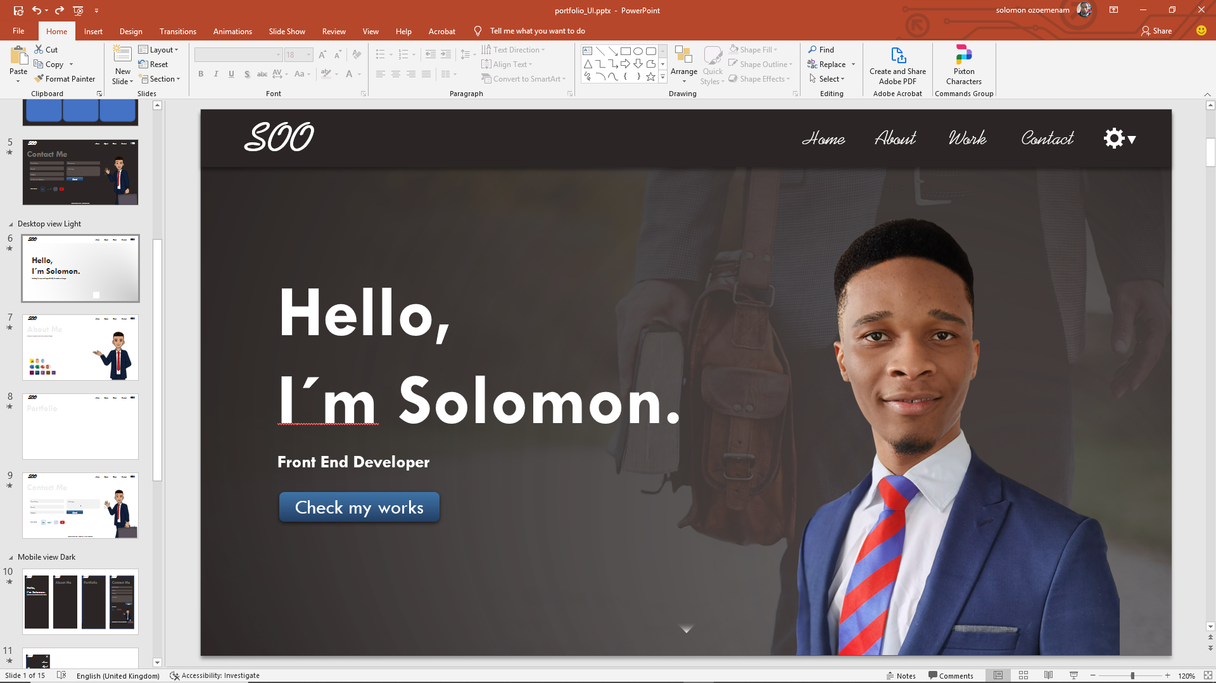

Slide 17
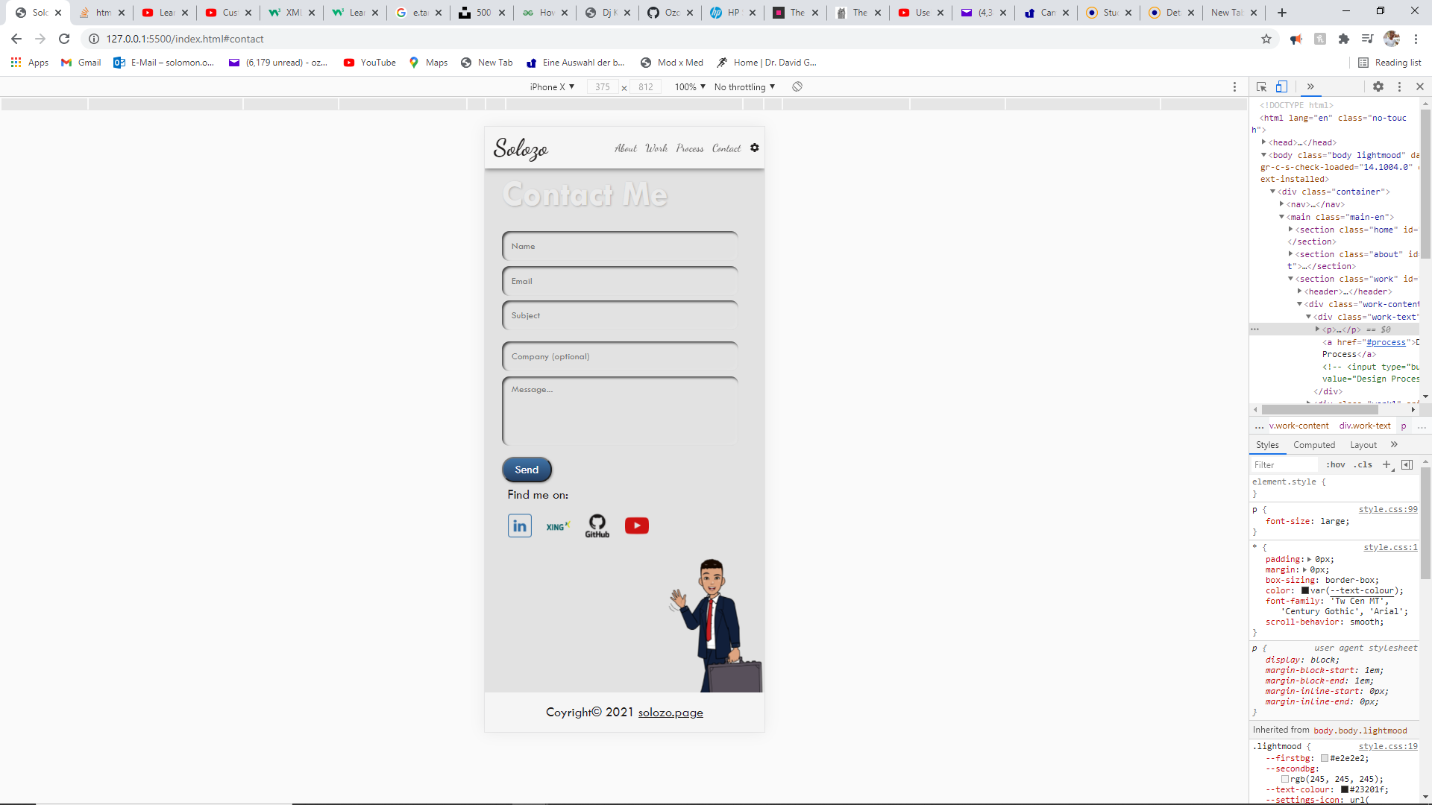
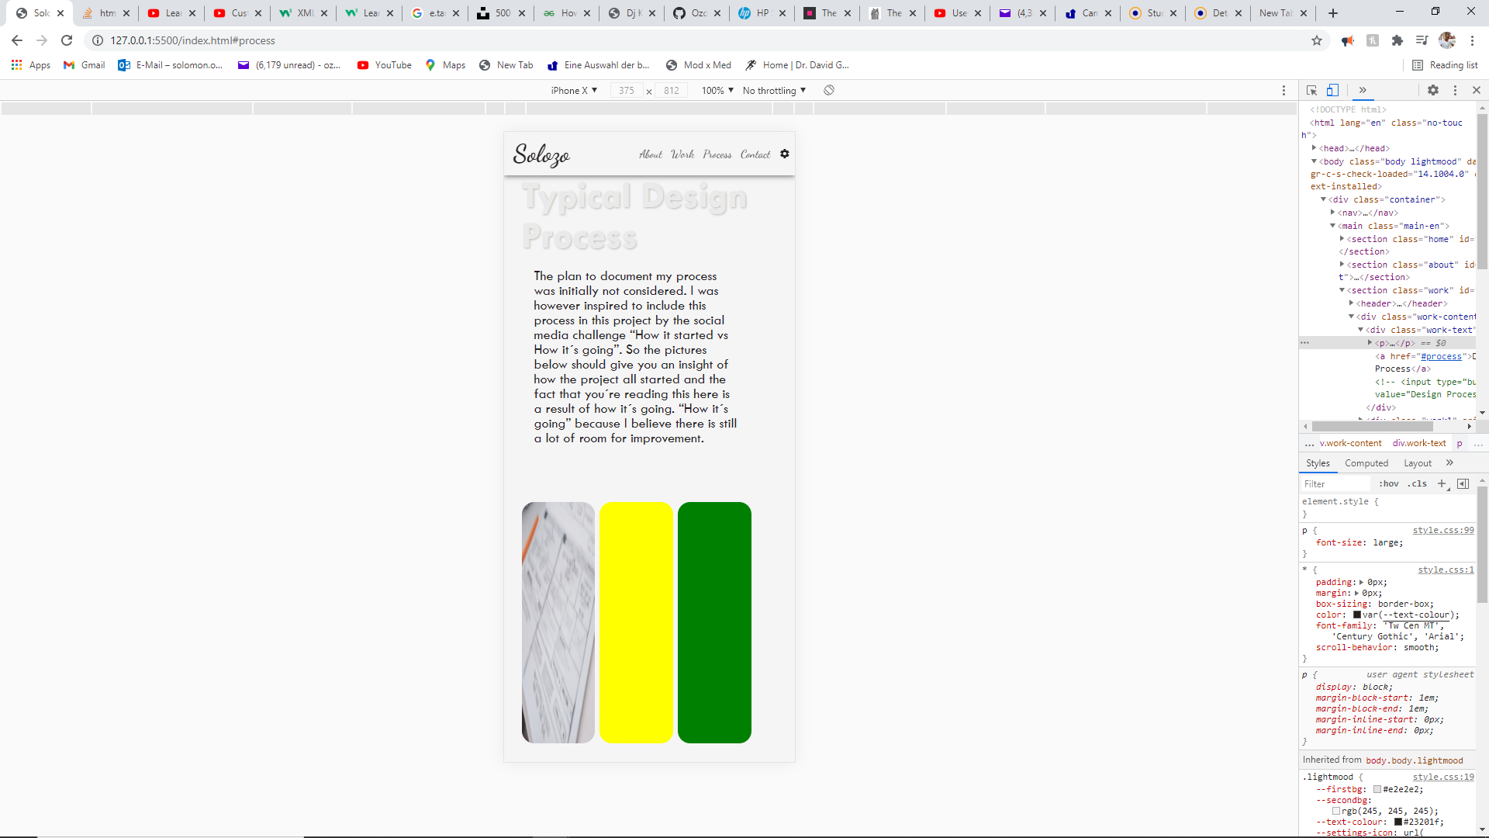
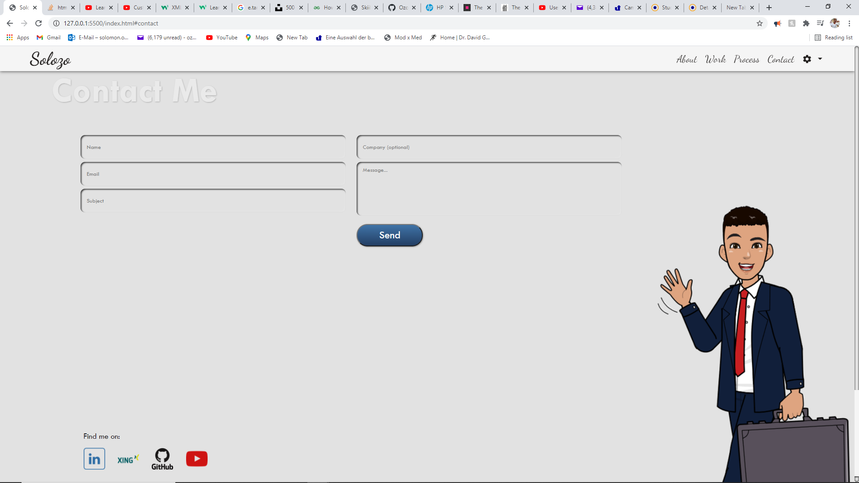
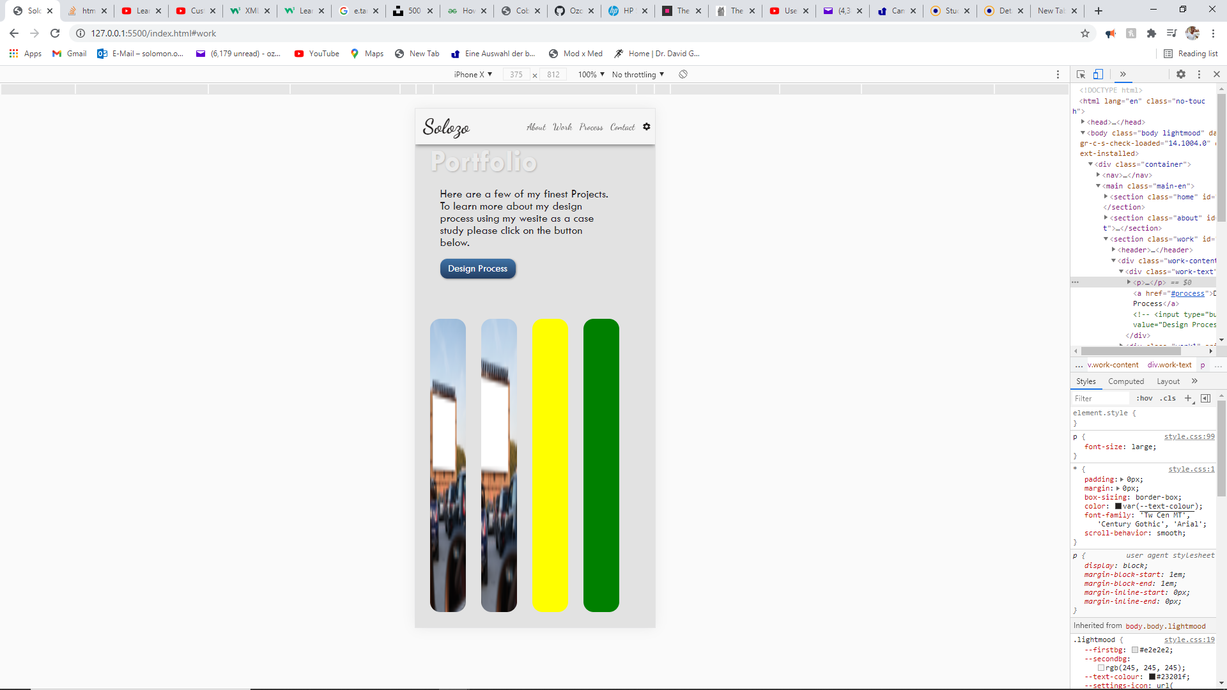
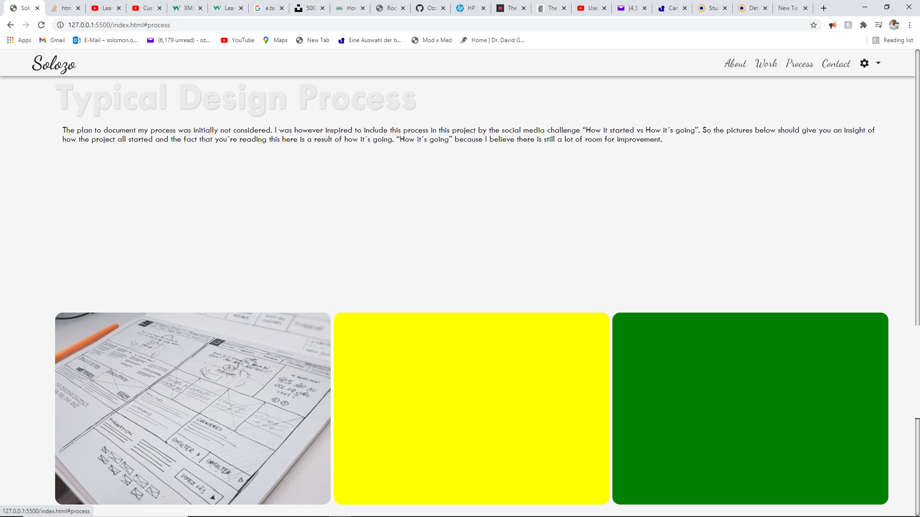
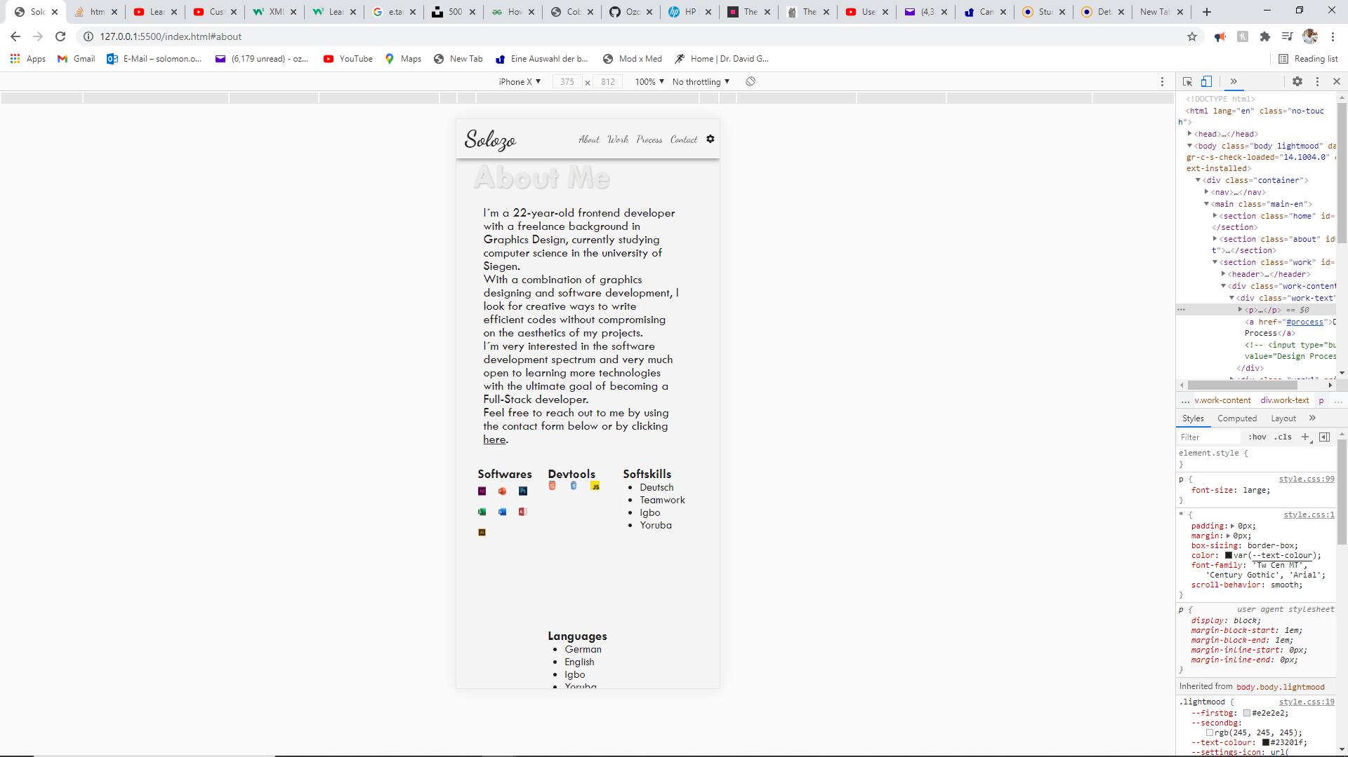
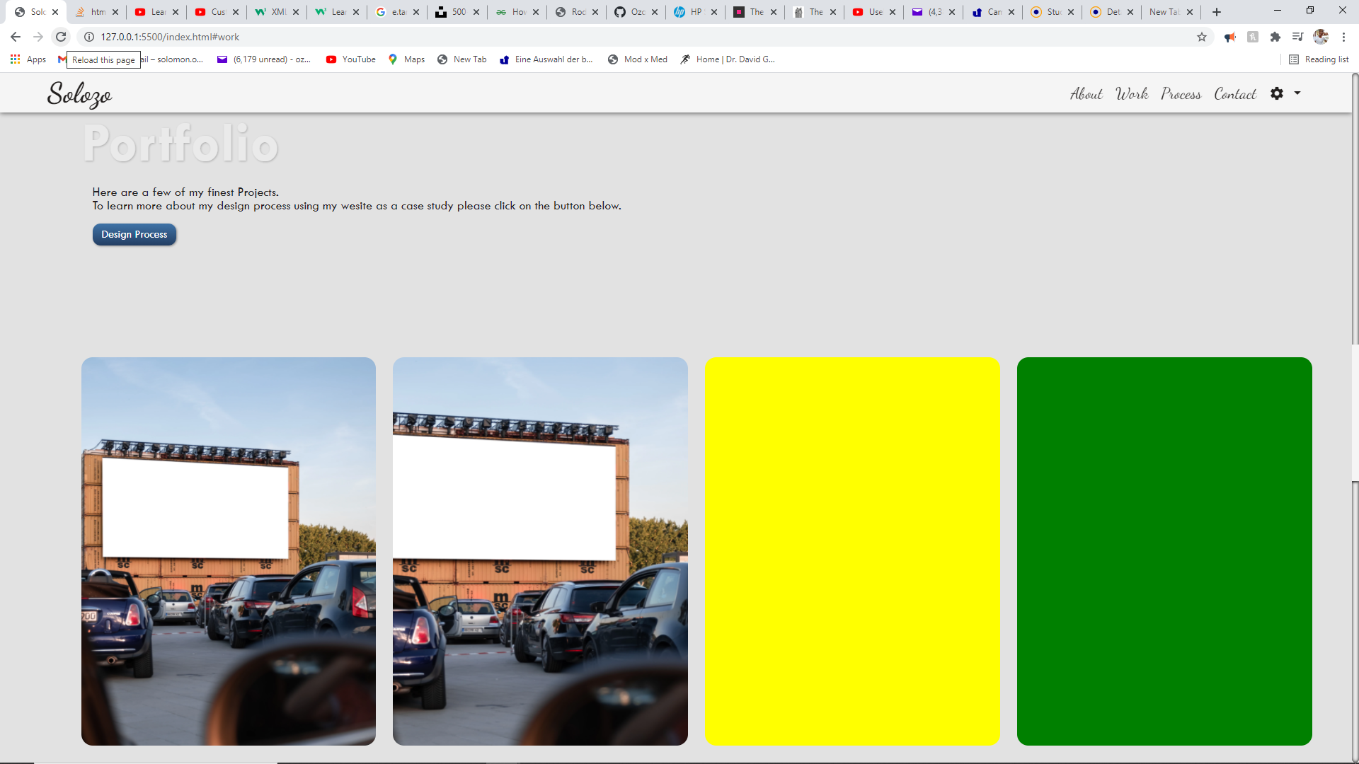
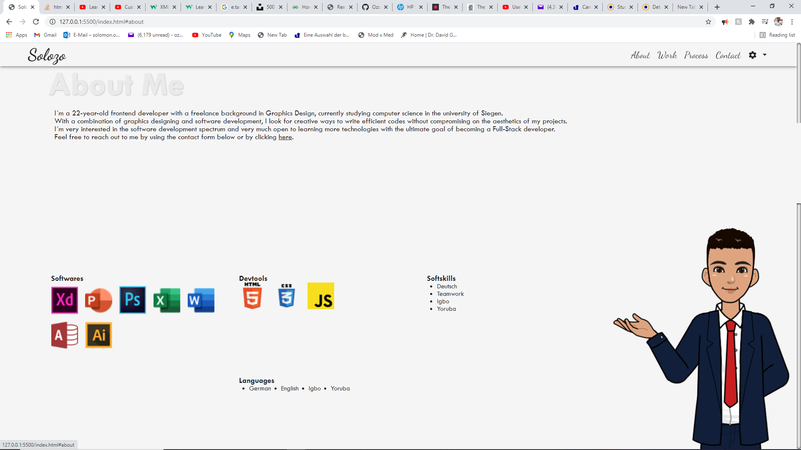
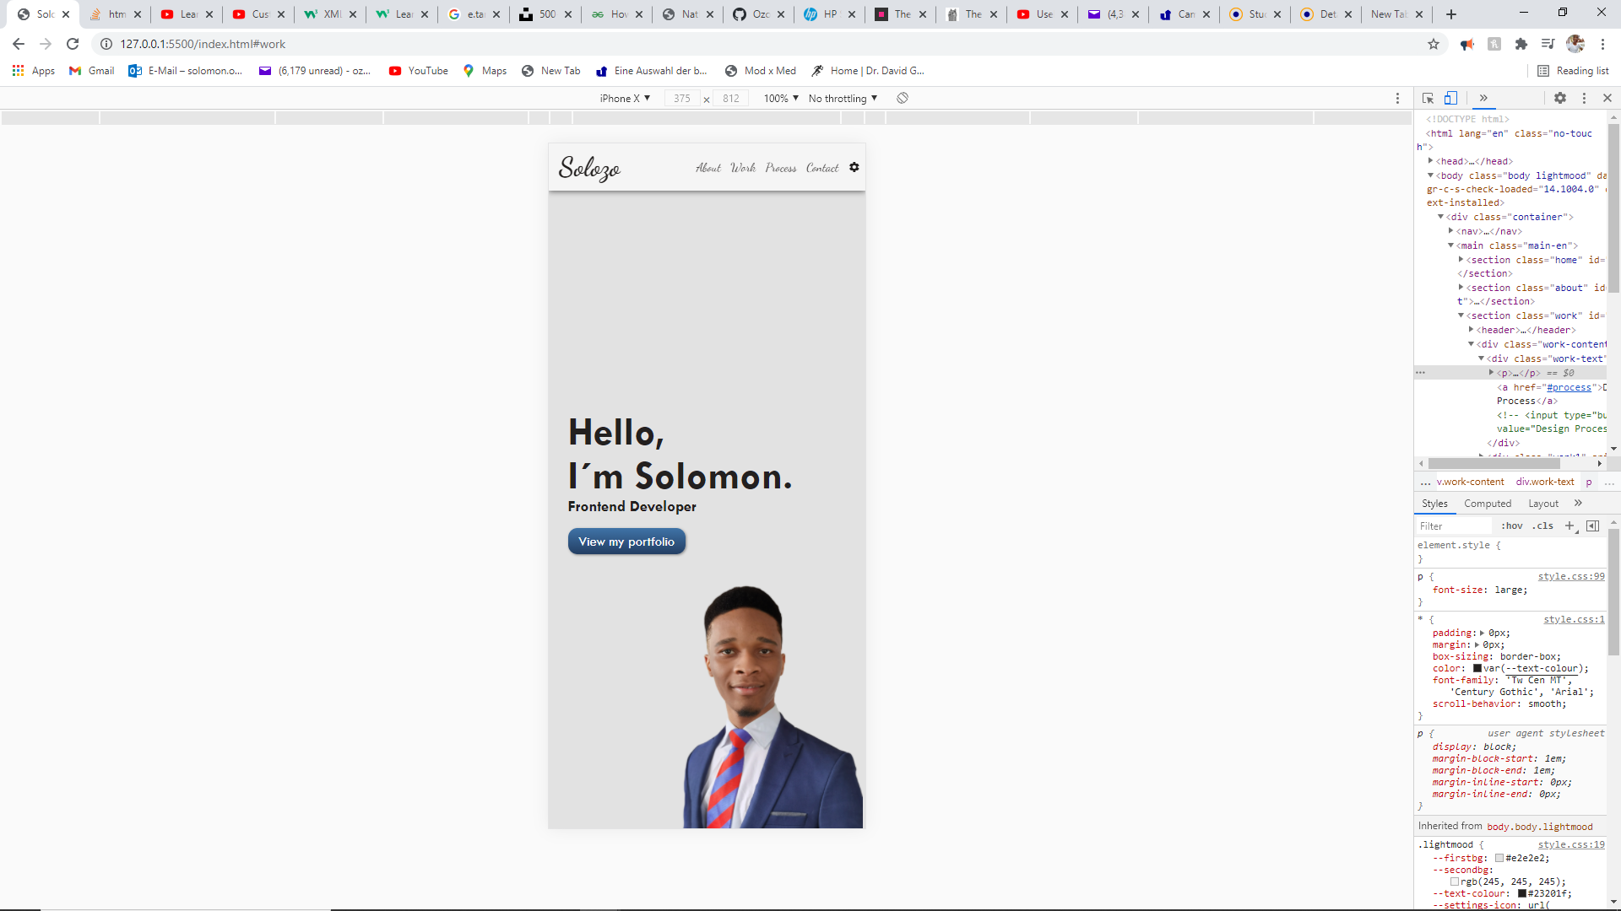
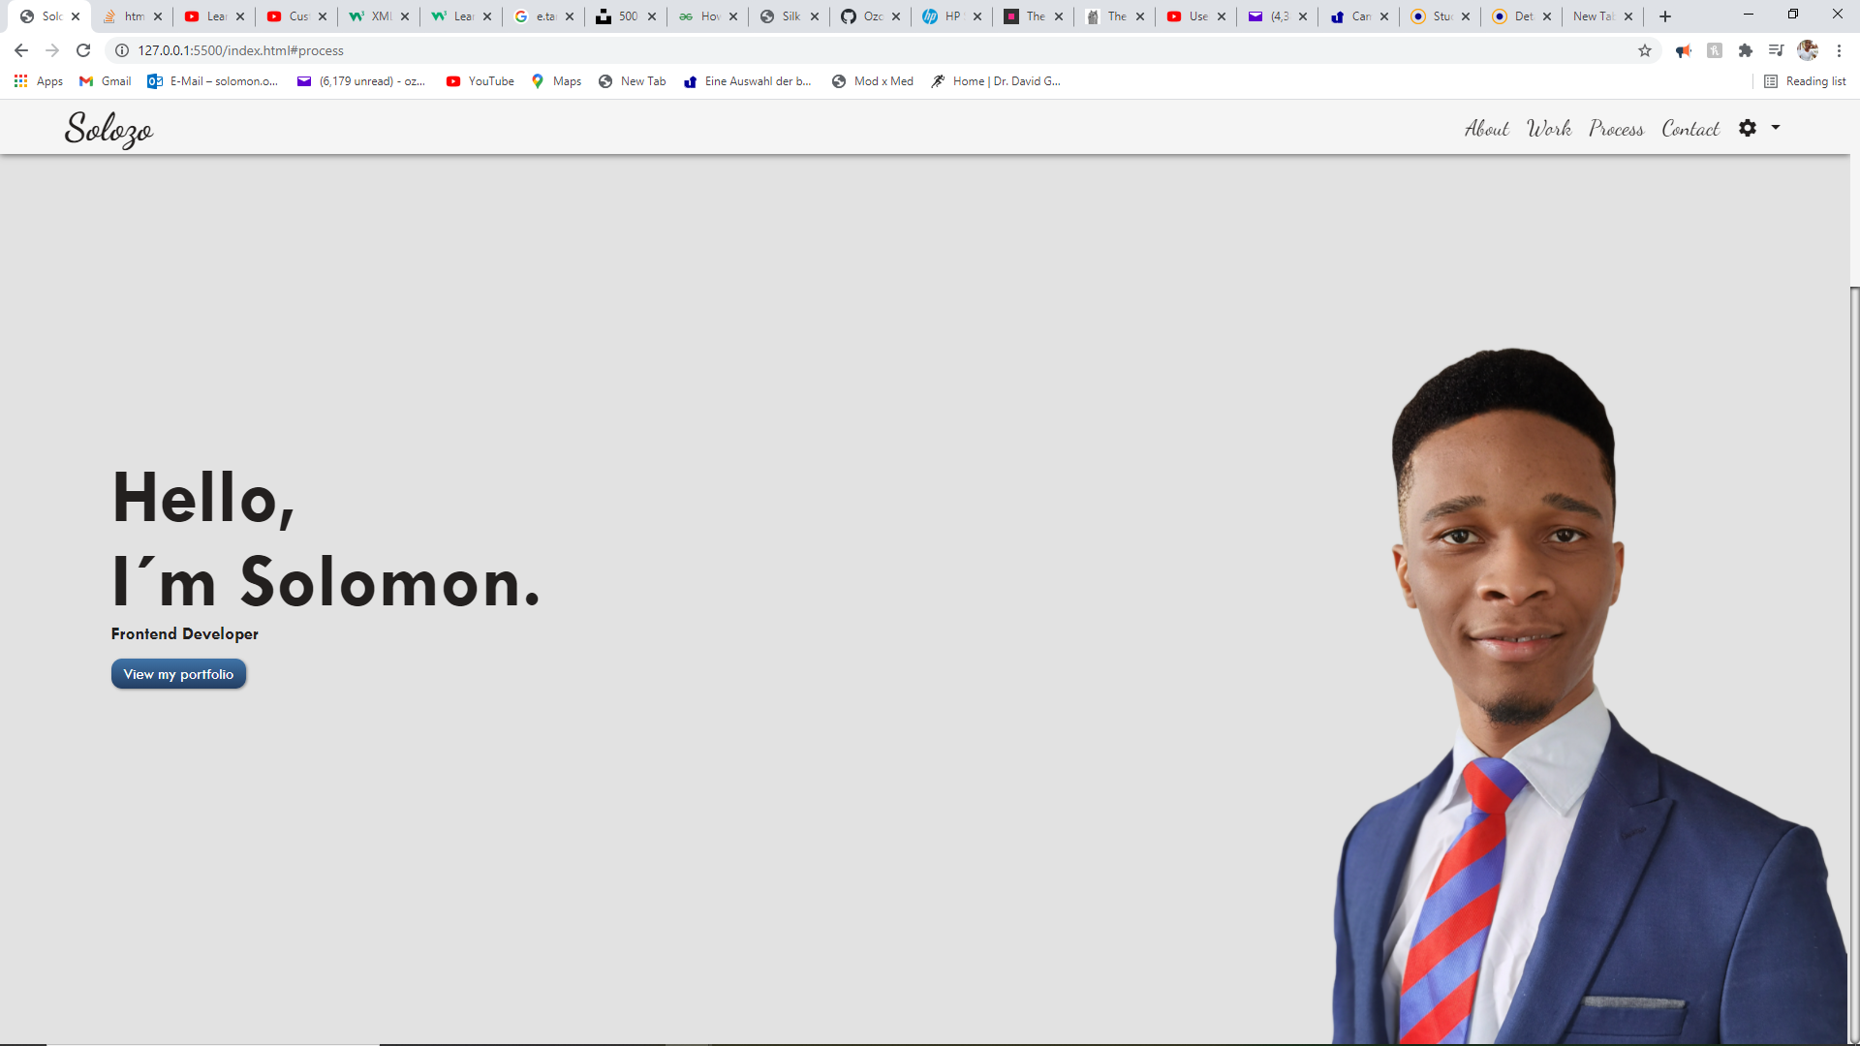

Slide 18
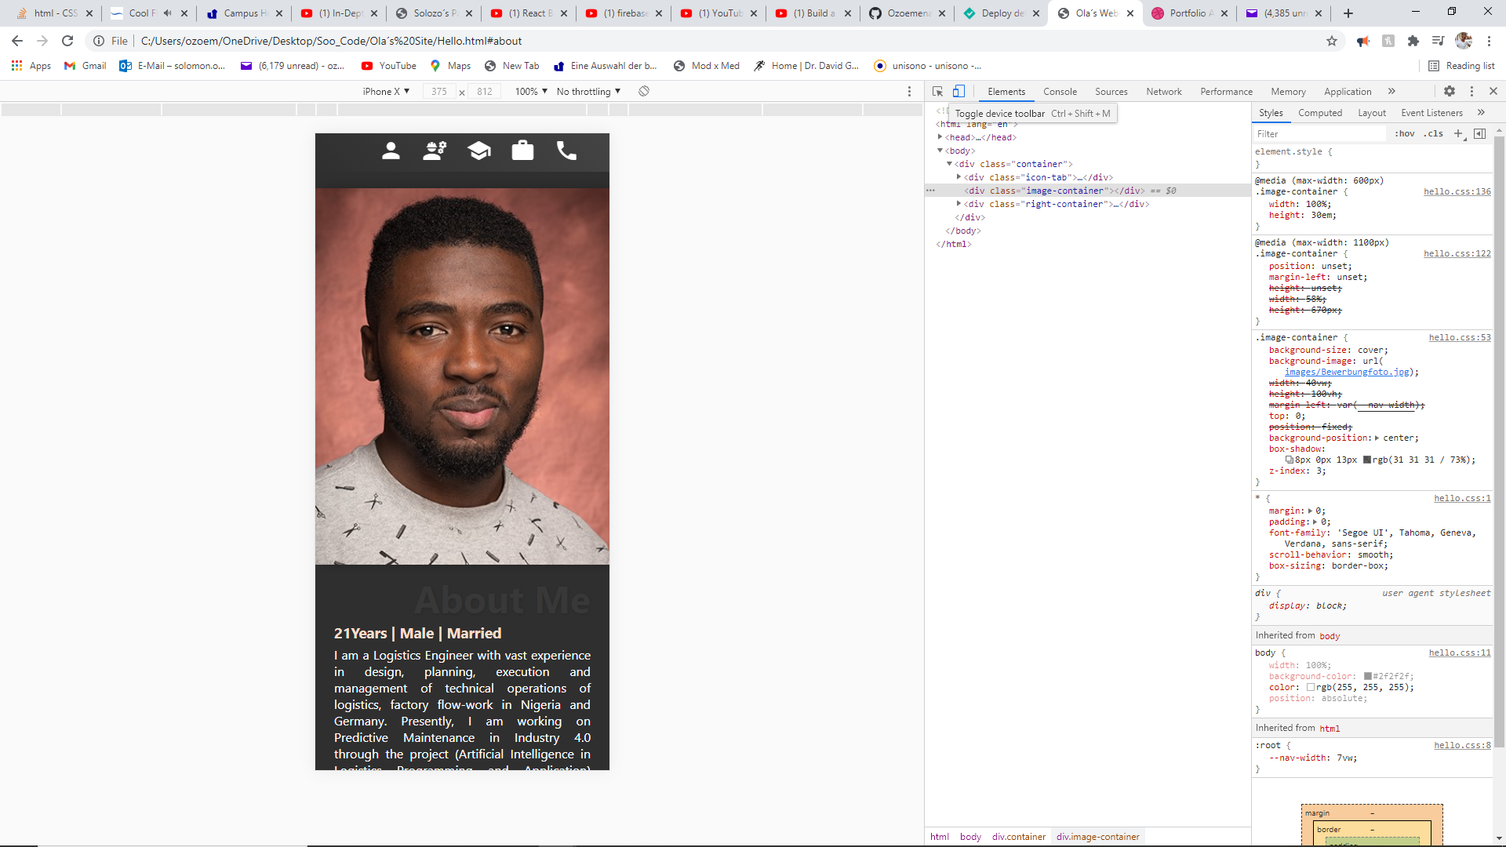
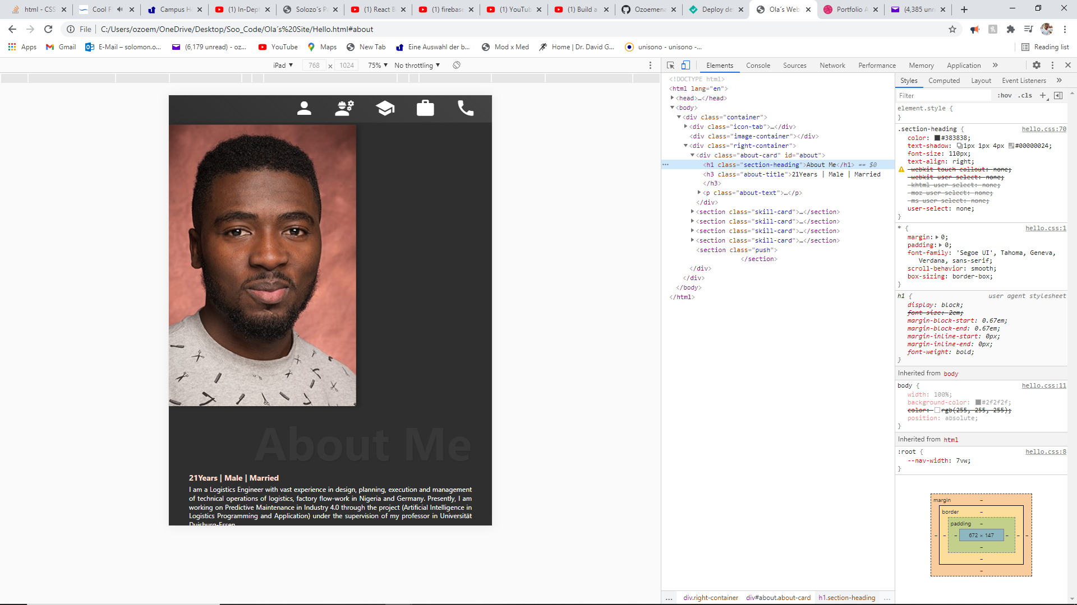
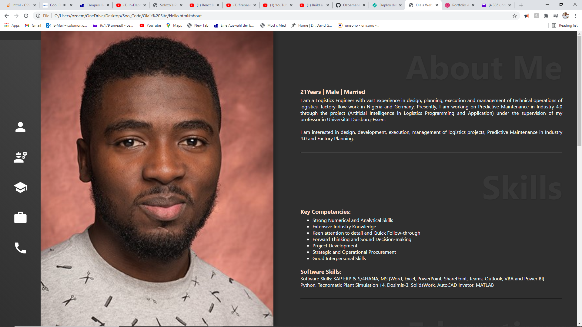

Slide 19
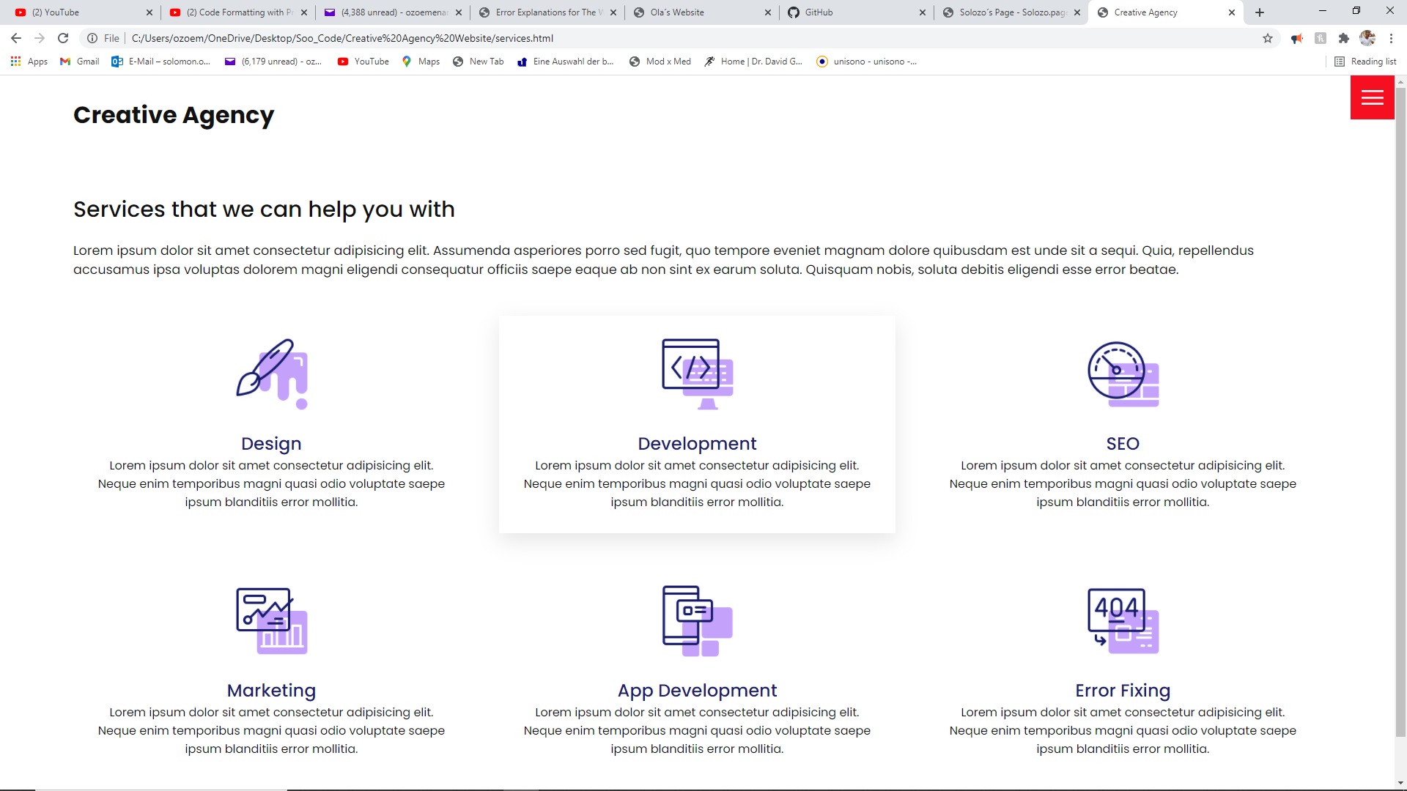
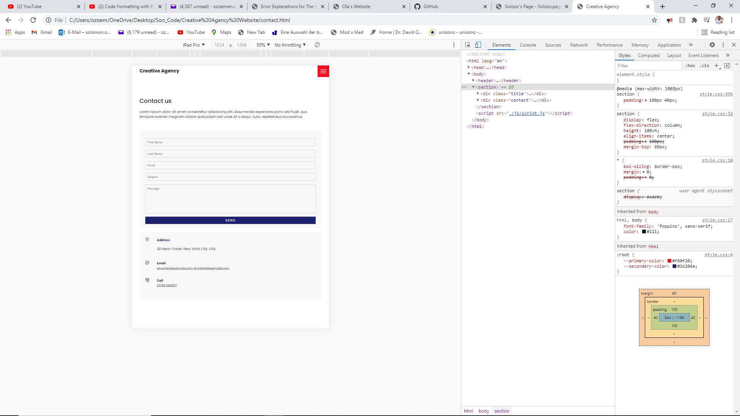
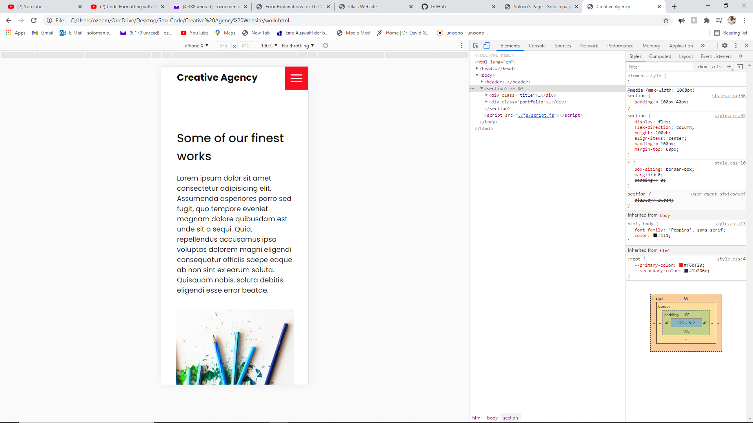
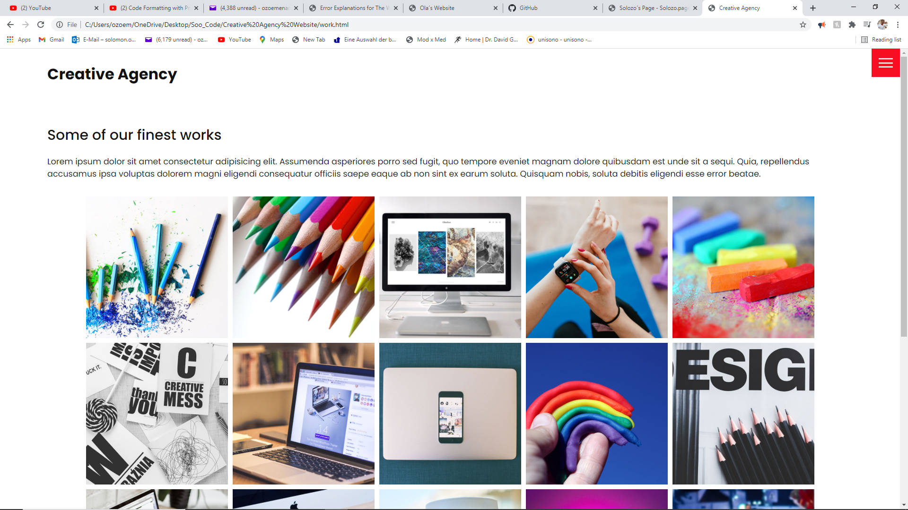

Slide 20
